Slide 1
Relative Motion Systems
Dr. Jacob Moore
Associate Professor of Engineering
Penn State Mont Alto

Slide 2
Relative Motion Analysis
Relative motion analysis is the analysis of the motion of one body, via observations from some other body or point that is also in motion.
In relative motion analysis, we wish to determine equations that relate the absolute positions, velocities, and accelerations of each of the bodies the relative observed positions, velocities, and accelerations.

Slide 3



Relative Motion in One Dimension
Let’s start with positions.
Imagine we are sitting stationary on the side of the road at point O.
From this stationary point, I see a police car (A) and a small white sedan (B) and I measure some distance to each.
O
A
B
x_{B/O}
x_{A/O}

Slide 4
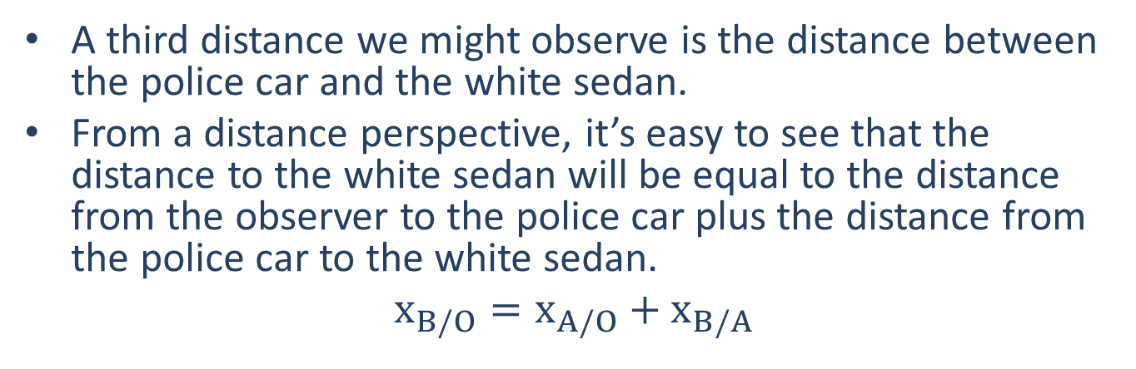
Relative Motion in One Dimension
A third distance we might observe is the distance between the police car and the white sedan.
From a distance perspective, it’s easy to see that the distance to the white sedan will be equal to the distance from the observer to the police car plus the distance from the police car to the white sedan.
$$x_{B/O}=x_{A/O}+x_{B/A}$$
O
A
B
x_{B/O}
x_{A/O}
x_{B/A}

Slide 5

Relative Motion Notation
Let’s take a second to discuss the notation we are using for relative motion, specifically the subscripts.
$$x_{B/O}$$
Position, velocity, or acceleration
The point we are observing from
The point we are observing

Slide 6
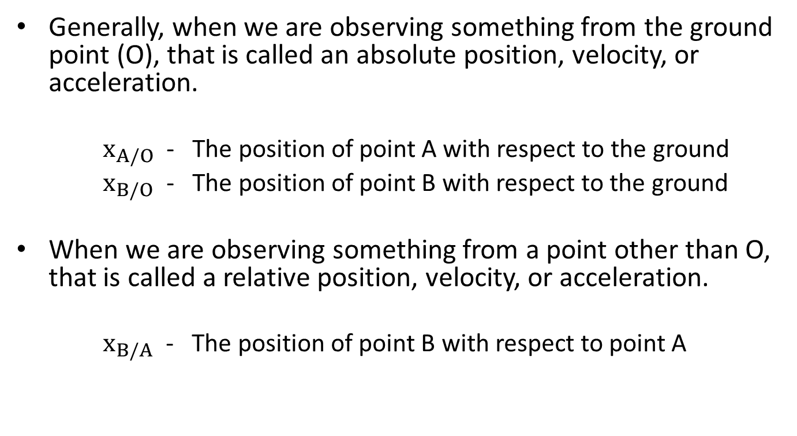
Relative Motion Notation
Generally, when we are observing something from the ground point (O), that is called an absolute position, velocity, or acceleration.
$x_{A/O}$ - The position of point A with respect to the ground
$x_{B/O}$ - The position of point B with respect to the ground
When we are observing something from a point other than O, that is called a relative position, velocity, or acceleration.
$x_{B/A}$ - The position of point B with respect to point A

Slide 7
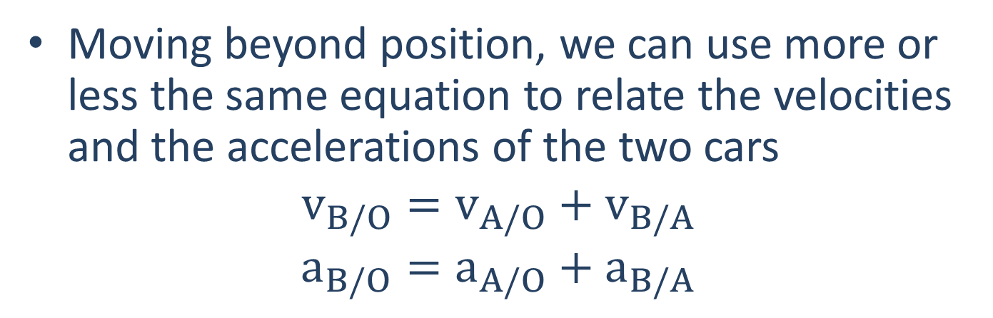
Relative Motion in One Dimension
Moving beyond position, we can use more or less the same equation to relate the velocities and the accelerations of the two cars
$$v_{B/O}=v_{A/O}+v_{B/A}$$
$$a_{B/O}=a_{A/O}+a_{B/A}$$
O
A
B
v_{A/O}
v_{B/O}

Slide 8
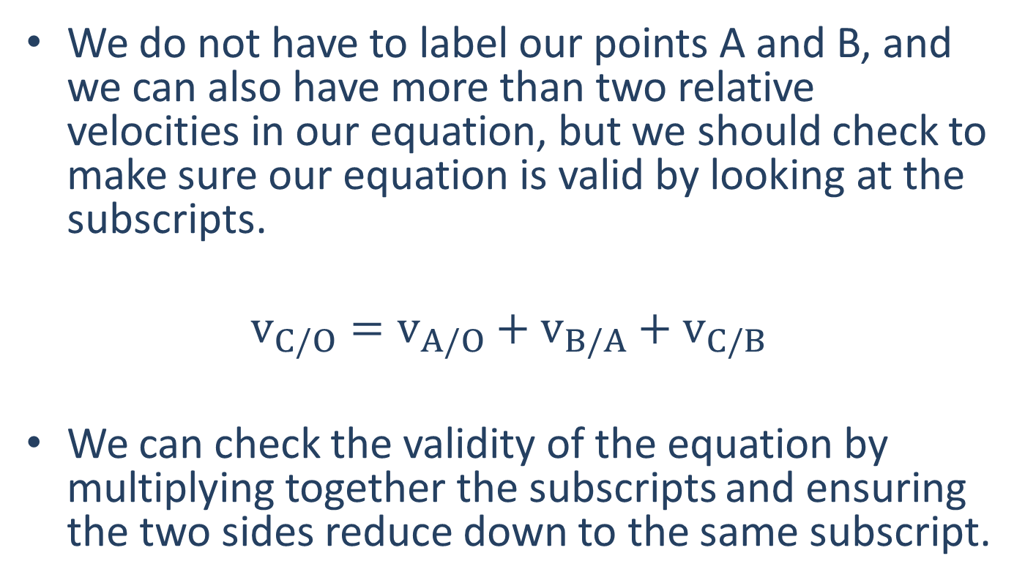
Checking the Equations
We do not have to label our points A and B, and we can also have more than two relative velocities in our equation, but we should check to make sure our equation is valid by looking at the subscripts.
$$v_{C/O}=v_{A/O}+v_{B/A}+v_{C/B}$$
We can check the validity of the equation by multiplying together the subscripts and ensuring the two sides reduce down to the same subscript.

Slide 9

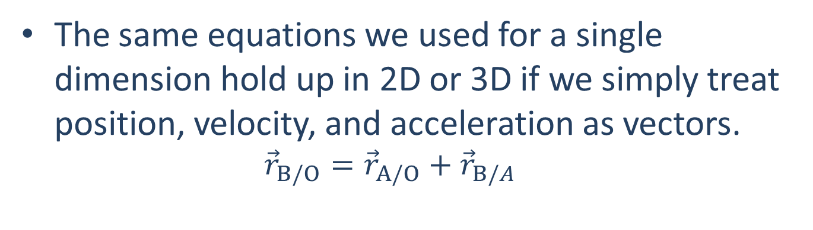
Relative Motion 2D
The same equations we used for a single dimension hold up in 2D or 3D if we simply treat position, velocity, and acceleration as vectors.
$${\vec{r}}_{B/O}={\vec{r}}_{A/O}+{\vec{r}}_{B/A}$$
B
r_{B/O}
r_{B/A}
r_{A/O}
A
O

Slide 10
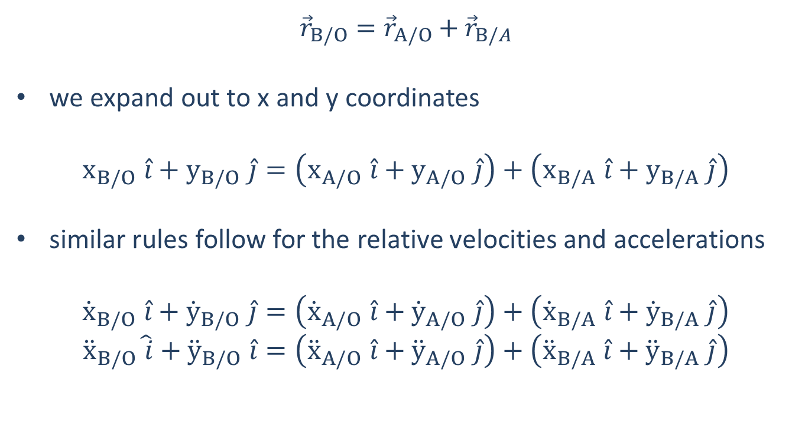
Relative Motion 2D (Rectangular Coordinates)
$${\vec{r}}_{B/O}={\vec{r}}_{A/O}+{\vec{r}}_{B/A}$$
we expand out to x and y coordinates
$x_{B/O} \hat{i}+y_{B/O} \hat{j}=\left(x_{A/O} \hat{i}+y_{A/O} \hat{j}\right)+\left(x_{B/A} \hat{i}+y_{B/A} \hat{j}\right)$
similar rules follow for the relative velocities and accelerations
${\dot{x}}_{B/O} \hat{i}+{\dot{y}}_{B/O} \hat{j}=\left({\dot{x}}_{A/O} \hat{i}+{\dot{y}}_{A/O} \hat{j}\right)+\left({\dot{x}}_{B/A} \hat{i}+{\dot{y}}_{B/A} \hat{j}\right)$
${\ddot{x}}_{B/O}\hat{ i}+{\ddot{y}}_{B/O} \hat{i}=\left({\ddot{x}}_{A/O} \hat{i}+{\ddot{y}}_{A/O} \hat{j}\right)+\left({\ddot{x}}_{B/A} \hat{i}+{\ddot{y}}_{B/A} \hat{j}\right)$

Slide 11

Relative Motion 2D (Rectangular Coordinates)
Breaking this out into x and y equations
Position:
$$x_{B/O}=x_{A/O}+x_{B/A}$$
$$y_{B/O}=y_{A/O}+y_{B/A}$$
Velocity:
$${\dot{x}}_{B/O}={\dot{x}}_{A/O}+{\dot{x}}_{B/A}$$
$${\dot{y}}_{B/O}={\dot{y}}_{A/O}+{\dot{y}}_{B/A}$$
Acceleration:
$${\ddot{x}}_{B/O}={\ddot{x}}_{A/O}+{\ddot{x}}_{B/A}$$
$${\ddot{y}}_{B/O}={\ddot{y}}_{A/O}+{\ddot{y}}_{B/A}$$

Slide 12
Relative Motion in Normal-Tangential and Polar Coordinates
In the rectangular coordinate systems, the x and y directions were universal (same directions for all bodies)
We can add all the x components and add all the y components
In the normal-tangential and polar coordinate systems the n and t or r and theta directions will be different for each body.
We can’t add r components for example, when we have more than one r direction.
This makes it more difficult (but not impossible) to work with these coordinate systems.

Slide 13
Thanks for Watching
See other engineering mechanics videos and access the full tool at…

Slide 14


Worked Example
A police officer notices a car speeding by. If the police car is traveling 30 m/s and the radar gun measures the relative velocity to be 15 m/s, how fast is the speeding car actually going? If the police car immediately begins accelerating at a constant rate and catches up to the speeding car after 15 seconds, what is the rate of acceleration of the police car?
A
B
$$v_{o}=30\frac{m}{s}$$
$$v_{o}= ?$$

Slide 15
Worked Example
A plane has an airspeed of 250 kilometers per hour (airspeed is the velocity of the plane relative to the air) and is flying though an easterly crosswind with a speed of 20 kilometers per hour. If the plane wants to maintain a direct northerly course, what is the angle the plane must point into the wind (theta)?
250 kph
ϴ
20 kph

Slide 16
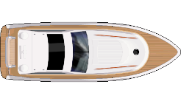
Worked Example
You are in a boat that is traveling through the water in an area of swift currents. One instrument measures your speed with respect to the water to be 20 ft/s with your boat pointed at a 45 degree angle. GPS however measures your absolute speed and direction to be 25 ft/s at a 55 degree angle. Based on this information, what is the speed and direction of the water current in this area?
25 ft/s
20 ft/s
55º
45º

